Slide 1

PRESENTATION ON
Understanding Multiple Access Techniques (FDMA, TDMA, CDMA) in Communication Networks

Slide 2
PRESENTED BY
Mohammad Borhan Uddin (ASH2101008M)
Faria Islam Mily (BFH2101015F)
Kazi Kawchar Ahmed

Slide 3
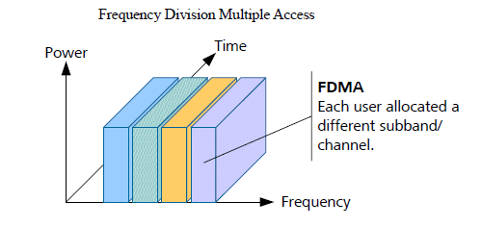
FDMA
Frequency Division Multiple Access
FDMA is a multiple access technique in which the available frequency spectrum is divided into distinct frequency bands. Each user is allocated a unique frequency band for simultaneous communication.
FDMA is analogous to a radio station where each station operates on a specific frequency.
Users can transmit and receive data on their assigned frequency band without interfering with others.
Commonly used in analog communication systems like traditional radio broadcasting.
Efficient for scenarios where users require continuous access to the communication medium.
For example, one 12.5kHz wide narrowband FM channel that previously carried only one conversation becomes two 6.25kHz sub-channels, each capable of carrying a separate conversation.

Slide 4
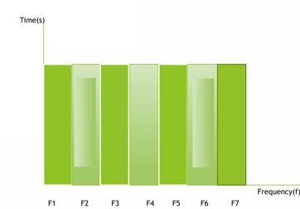
FDMA
Frequency Division Multiple Access
Features of FDMA
System used for low/medium traffic intensity
Narrow band interface resistance of the channel, but sensitive to interference
Simplicity of work equipment
Difficulty of insertion of the signaling associated with the call
Limitations for quality improvement
Graph of FDMA

Slide 5
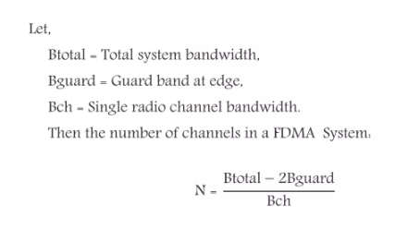
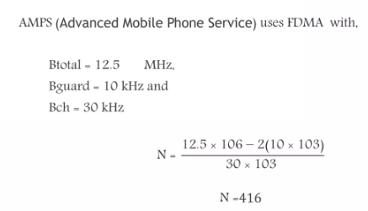
FDMA
Frequency Division Multiple Access
Number of Channel of FDMA
Example

Slide 6
FDMA
Frequency Division Multiple Access
Advantages of FDMA
Disadvantages of FDMA
If channel is not in use, it sits idle
Channel bandwidth is relatively narrow (30kHz)
Simple algorithmically and from a hardware standpoint
No need for network timing
The presence of guard brands
Maximum bit rate per channel is fixed
Small inhibiting flexibility in bit rate capability
Does not differ significantly from analog system.

Slide 7
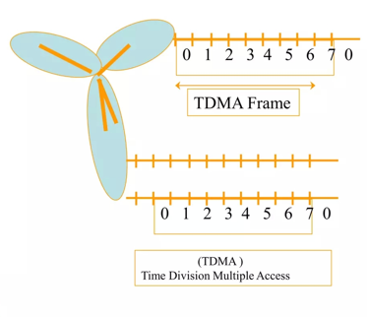
TDMA
Time Division Multiple Access
TDMA is a multiple access technique where the available time is divided into time slots. Each user is allocated specific time slots for data transmission, allowing multiple users to share the same frequency channel.
Several users share one frequency channel
Users have to wait for their turns to transmit or receive
TDMA frame length = 4.615 ms/ 8 Time slot

Slide 8
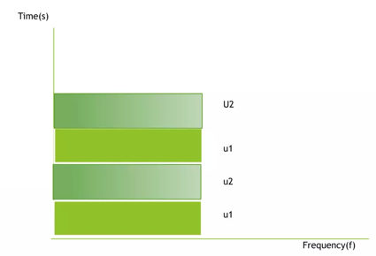
TDMA
Time Division Multiple Access
Graph of TDMA

Slide 9
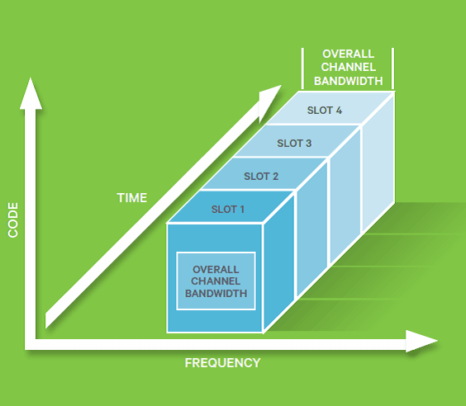
TDMA
Time Division Multiple Access
Features of TDMA
Access complexity, strict time synchronization
For high capacity system Traffic
Simplification of multi-channel stations
Delay in communication
Need for digitization of information
It achieves high quality
Possibility of using a single carrier frequency for both directions of communication

Slide 10
TDMA
Time Division Multiple Access
Advantages
Disadvantages
Flexible bit rate
No frequency guard band required
No need for precise narrowband filters
Extended battery life
The most cost-effective technology for upgrading a current analog system to digital
Requires network-wide timing synchronization
Requires signal processing for matched filtering and correlation detection
Demands high peak power on uplink in transient mode
Multipath distortion

Slide 11
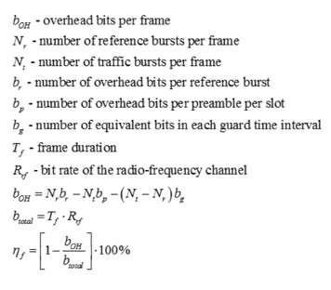
TDMA
Time Division Multiple Access
Efficiency of TDMA frame

Slide 12
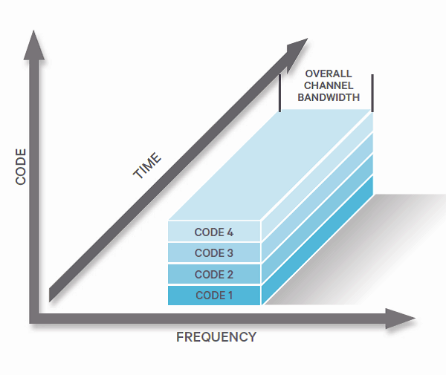
CDMA
Code Division Multiple Access
CDMA is a channel access method used by various radio communication technologies.
CDMA is an example of multiple access, where several transmitters can send information simultaneously over a single communication channel
This allows several users to share a band of frequencies
Fully digital wireless data transmission system
Users have control of a very wide channel bandwidth 1.5 to 5 MHz
Build-in interference minimization.

Slide 13
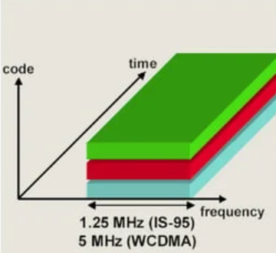
CDMA
Code Division Multiple Access
Basic diagram of CDMA
There exists a new dimension with time and frequency
The new dimension represent the code which provided by the operator for the user

Slide 14
CDMA
Code Division Multiple Access
Working of CDMA
CDMA is entirely a different approach from the Time Division Multiple Access. CDMA, after digitizing the data, spreads out the data over the entire available bandwidth. Multiple calls are overlapped to each other on a channel which is assigned with a unique sequence code. CDMA is a form Spread-Spectrum technique, which means data can be sent in small pieces over a number of frequencies available to use at any time in the specified range.

Slide 15
CDMA
Code Division Multiple Access
Working of CDMA
Below diagram show that there is only one channel which is accessing by four stations at the same time
Each channel has it’s own Code (i.e C1) and each channel wants to transmit data (i.e D1=0=-1)
Code will be assigned if it satisfies following to properties
Property 1: Pick any two stations’ code up and multiply them you will get a resultant and sum up the resultant if the it becomes to zero ‘0’, it will satisfy first property.
i.e: C1 X C2 = 0, (1111)(1-111-1) = 0
Property 2: Pick any stations code up and multiply it with own-self if you get the answer as equal to total number of stations, it will satisfy property two as well
i.e C1 X C1 = total No. stations. C1XC2 = 1111X1111=1111=4

Slide 16
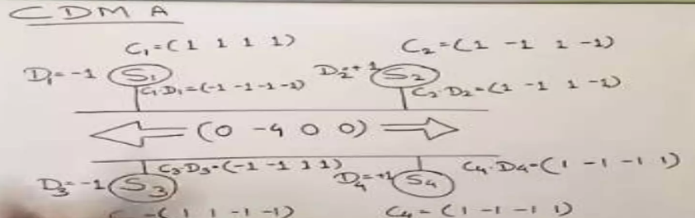
CDMA
Code Division Multiple Access
Working of CDMA
The next step is to multiply each Station’s code it’s own data (i.e C1XD1) you will get a resultant and sum up the resultants of all stations you will get a Channel code (i.e 0-4 0 0 0)

Slide 17
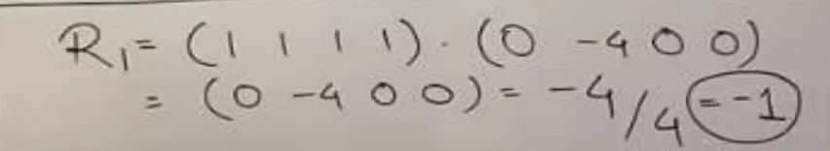
CDMA
Code Division Multiple Access
Working of CDMA
Once you have done with above steps at the Transmitter side the next step is to decode the data at receiver side
At the receiver side you will have to multiply the channel code with spreading code you will get a resultant
The next step is to sum up the resultant and divide the answer with total no. of stations you will get the actual data as shown in figure.

Slide 18
CDMA
Code Division Multiple Access
Advantages
Disadvantages
Improvement in capacity and security
Improvement in hand over/hand off
Use of wide Bandwidth
It has more number of users can share the same bandwidth
It is well-matched with other cellular technologies
The system is more complicated
Guard band and guard time both are required to be provided
As the number of users increases the overall quality of service decrease

Slide 19

Questions ?

Slide 20
Thank you!

